Slide 1

Competitive Programming From Problem 2 Solution in O(1)
P
T
H
I
N
K
F
A
S
T
S
C++: Practice – 1D Arrays - 1
Mostafa Saad Ibrahim
PhD Student @ Simon Fraser University

Slide 2
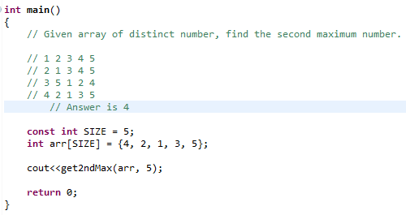
2nd Maximum in Array

Slide 3
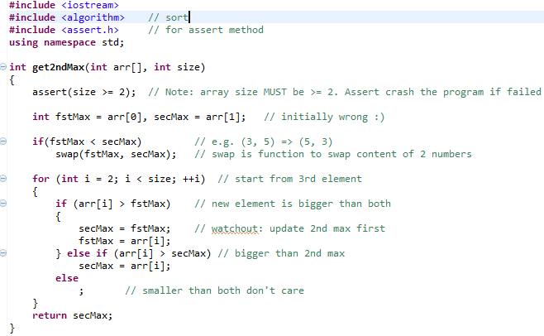
2nd Maximum in Array

Slide 4
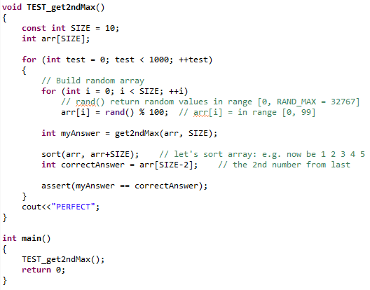
TEST 2nd Maximum in Array

Slide 5
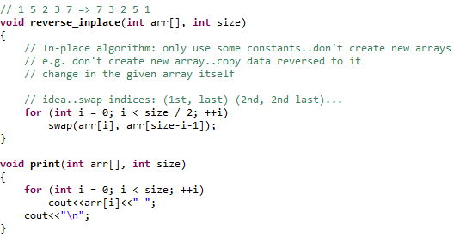
Reverse in-place

Slide 6
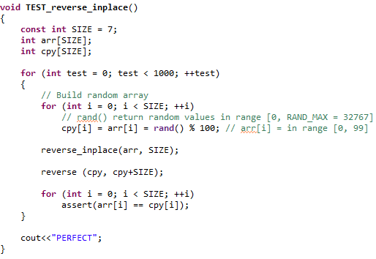
TEST: Reverse in-place
What is wrong?

Slide 7
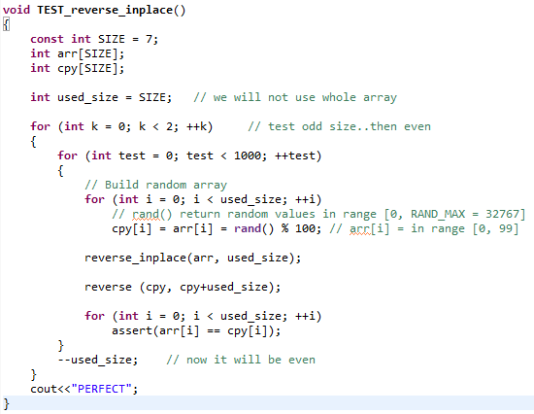
TEST: Reverse in-place - Fix

Slide 8
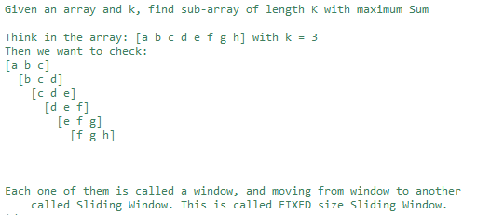
Sliding Window

Slide 9
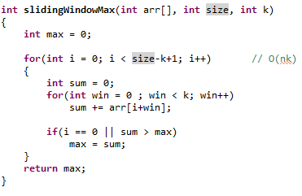
Algorithm 1: Size x K Operations

Slide 10
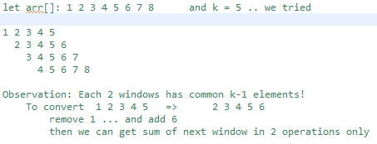
Observations for faster program?

Slide 11
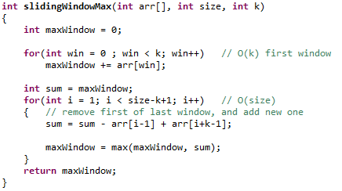
Algorithm 2: Size + K Operations

Slide 12
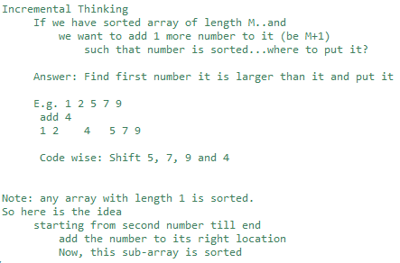
Sorting Arrays

Slide 13
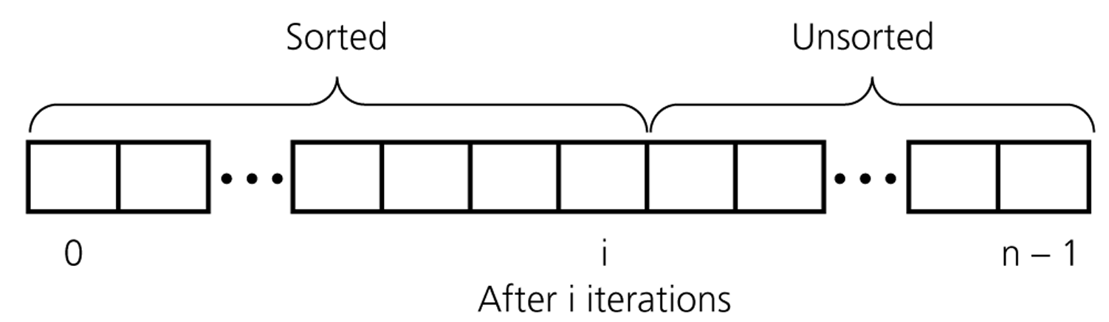
Sorting Arrays
Src: http://www.cs.sfu.ca/CourseCentral/225/jmanuch/lec/6-2.ppt

Slide 14
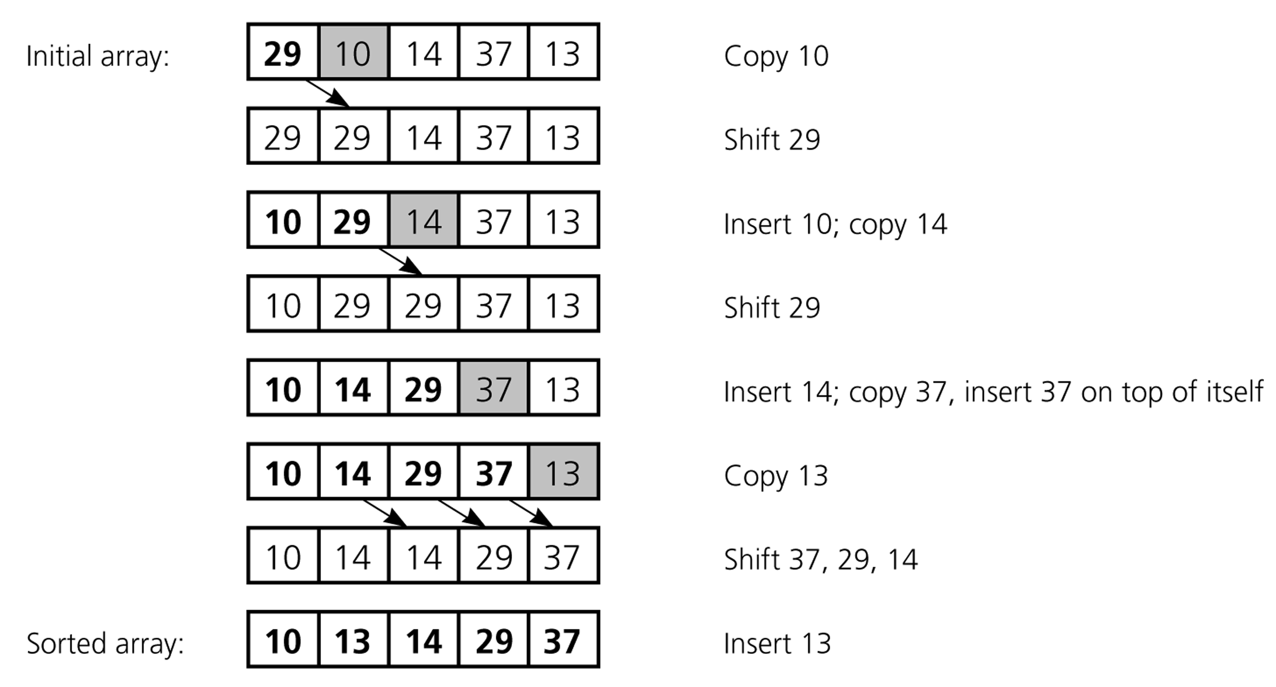
Sorting Arrays: Simulation
Src: http://www.cs.sfu.ca/CourseCentral/225/jmanuch/lec/6-2.ppt

Slide 15
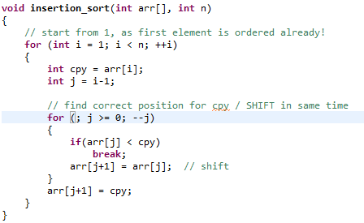
Sorting Arrays Algorithm

Slide 16
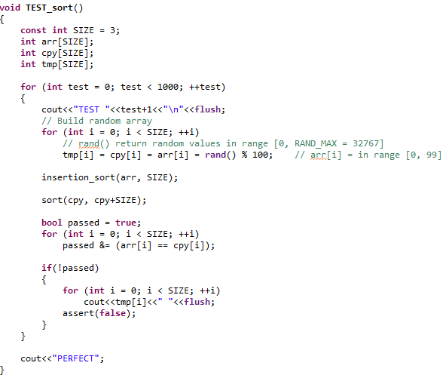
Sorting Arrays Testing

Slide 17
Sorting Arrays: Test Cases Design
It is more benifical too to think about test cases by yourself not random test
Always before coding...think in test cases
This way you have vision about to consider versus blind coding
One thinking stream: how to test sorting problem
Other stream: how to test sorting given my algorithm design

Slide 18
Sorting Arrays: Test Cases Design
Array length: We need to test length 1, 2 and > 2
5
5 7
7 5
Add new element to sorted array have 3 scenarios
No change: [3 6 8 9] + 15
Move to meduim: [3 6 8 9] + 7
Move to start [3 6 8 9] + 1
We also may want to test dublicate: [3 6 8 9] + 3
Does –ve matters? [-3 6 8 9] + -1
Order: Could we sort 1000000 number? Extermly slow: 10^12
Be creative ☺...Consider all possible cases

Slide 19
Merge 2 sorted arrs
Given 2 sorted arrays..sort them in 1 array
int a[5] = {1, 10, 100, 1000, 1001};
int b[3] = {2, 4, 150};
Result: 1 2 4 10 100 150 1000 1001
Think about 1st element in each array: 1 vs 2
1 is smalle than 2..so 1st element in result must be 1
Now, imaging a lost its first number
int a[4] = {10, 100, 1000, 1001};
int b[3] = {2, 4, 150};
Think about 1st element in each array: 10 vs 2 => 2

Slide 20
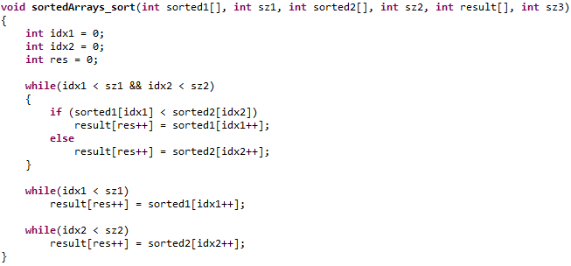
Merge 2 sorted arrs

Slide 21
Merge 2 sorted arrs

Slide 22
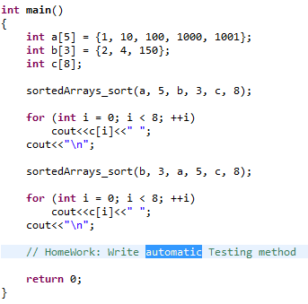
Merge 2 sorted arrs
Design Manual Cases ☺

Slide 23
تم بحمد الله
علمكم الله ما ينفعكم
ونفعكم بما تعلمتم
وزادكم علماً

